Slide 1

LEAD SCORING CASE STUDY

Slide 2
PROBLEM STATEMENT
X Education faces a low lead conversion rate of around 30% despite a high
number of leads.
Objective: Increase efficiency by identifying 'Hot Leads' for a higher conversion rate.
Tasked with building a model to assign lead scores, prioritizing leads with a higher likelihood of conversion.
CEO's target: Achieve an 80% lead conversion rate for improved sales
efficiency.

Slide 3
BUSINESS OBJECTIVE
Outline the approach briefly:
➢ Data Overview: 9000 data points, key attributes, 'Converted' as the target
variable.
Logistic Regression Model: Assign lead scores between 0 and 100.
➢ Results: Conversion predictions, evaluation metrics (accuracy, precision,
recall, F1-score).
➢ Conclude with key recommendations for X Education based on the model's
insights.
➢ Optionally, include a visual representation of the lead conversion process
funnel.

Slide 4
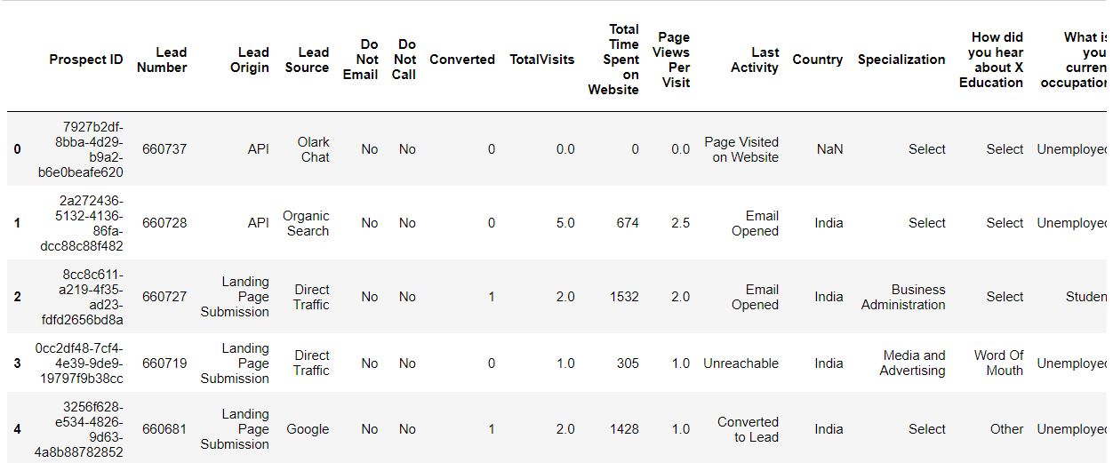
DATA SET
▪ 9000 data points with various attributes: Lead Source, Total Time Spent, Total Visits, Last Activity, etc.
▪ Target variable: 'Converted' (1 for converted, 0 for not converted).
▪ Check categorical variables for levels, especially 'Select' (considered as null value).
▪ Refer to the data dictionary in the provided zip folder for detailed
dataset insights.

Slide 5
Approach & Methodology:
➢ Checking the missing values
➢ Handling outliers.
➢ Differentiates numerical columns and categorical columns.
➢ Univariate and Bivariate analysis.
➢ Correlations.
➢ Data Preparations
➢ Train Test Split
➢ Feature Scaling
➢ Model Building
➢ Checking Variance Inflation Factor (V.I.F)
➢ Confusion Matrix
➢ Plotting ROC Curve
➢ Finding optimal cut-off point
➢ Accuracy, Sensitivity, Specificity
➢ Precision And Recall

Slide 6
DATA CLEANING:
There is a lot of columns with high number of missing values and since we have around 9000+ data points we can eliminate the columns with 30% missing values;
We dropped City and Country variables since it’s of no use to us as the company provides online courses;
Prospect ID and Lead Number are just records identifier and as hence dropped.
We dropped all columns which have skewed data points as it wont have any predictability

Slide 7
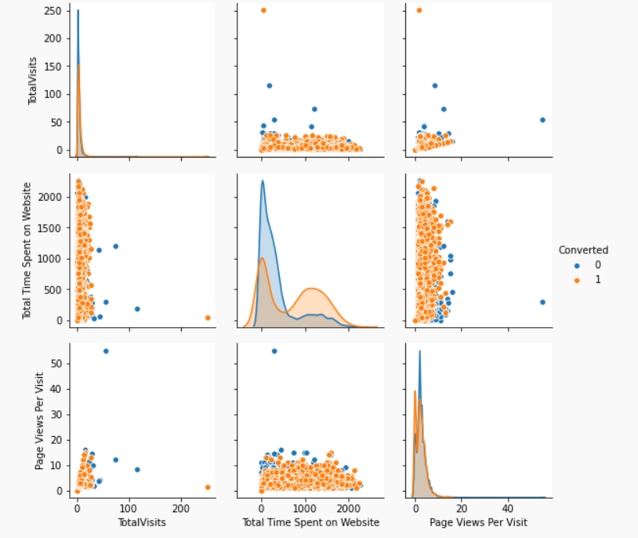
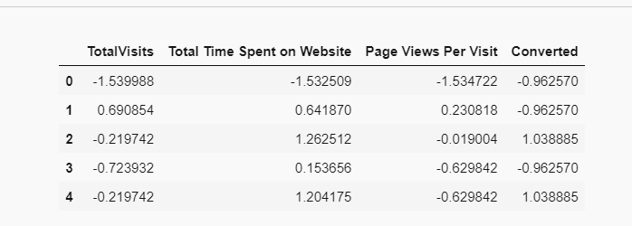
DATA MODELING:

Slide 8
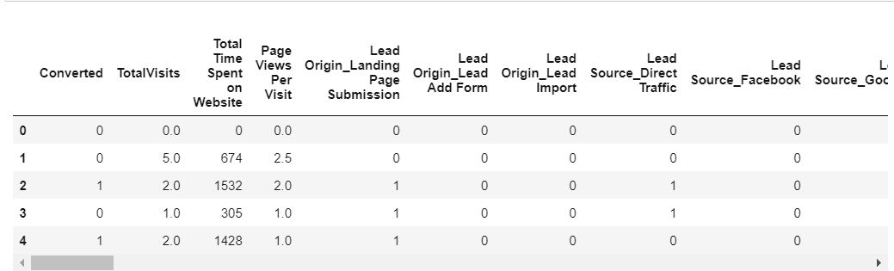
Data Preparation
After dummification : -

Slide 9
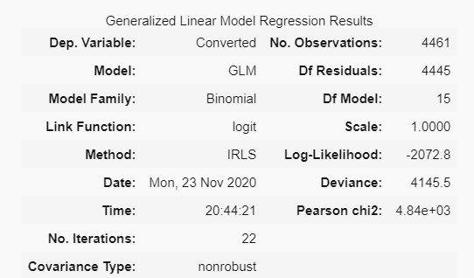
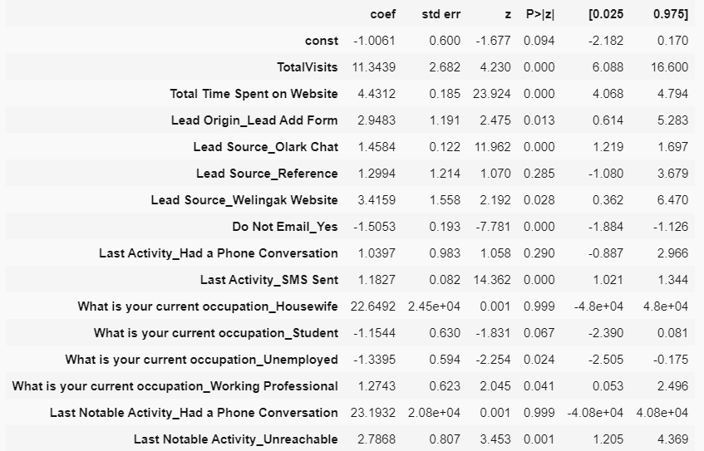
Model Building
After creating a RFE we got are model as shown below :

Slide 10
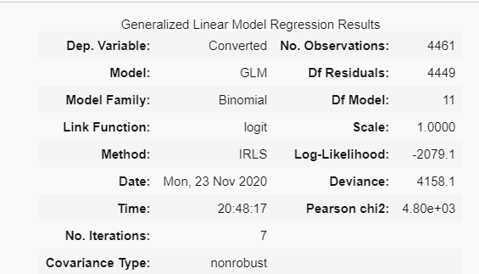
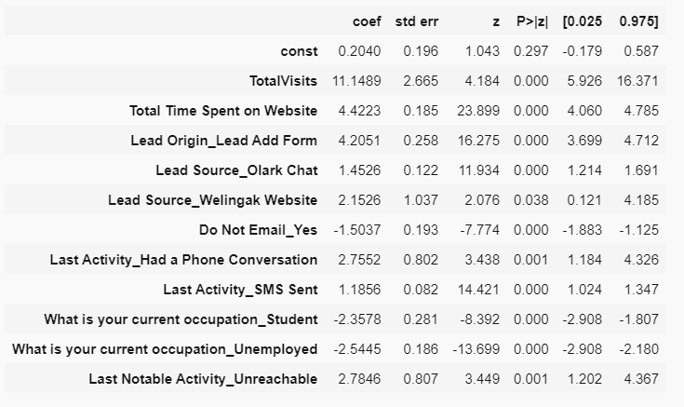
Model Building
After Removing the variables with high p-value finally we got are final model as shown below:

Slide 11
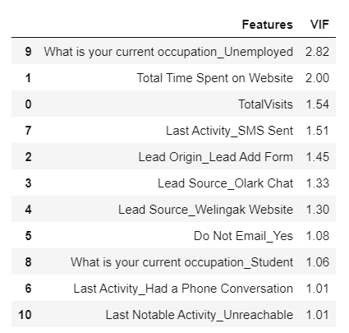
Variance Influence Factor (V.I.F)
V.I.F Values for the final model :

Slide 12
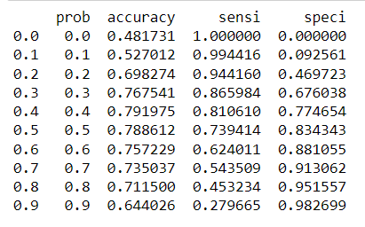
MODEL EVALUATION

Slide 13
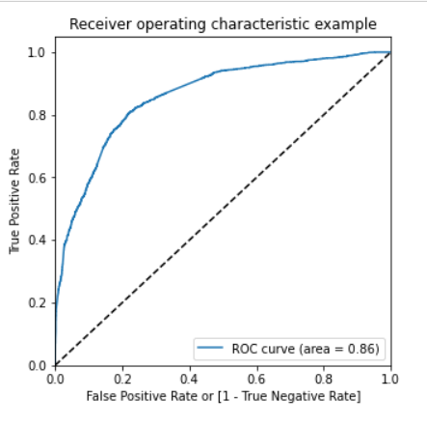
ROC Curve

Slide 14
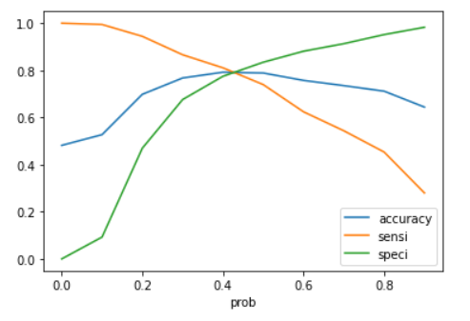
Optimal Cut-off point – (0.4)

Slide 15
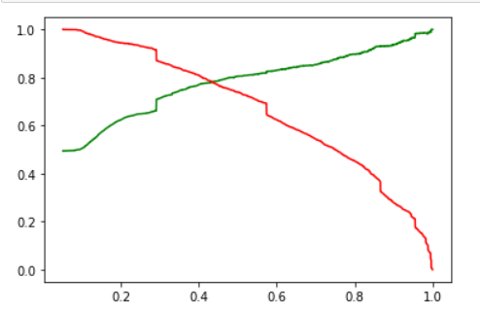
Probability

Slide 16
INFERENCES
Top three variables in your model which contribute most towards the probability of a lead getting converted :
a. Total Visits,
b. Total Time Spent on Website,
c. Lead Origin_Lead Add Form
Top 3 categorical/dummy variables in the model which should be focused the most on in order to increase the probability of lead conversion :
a. Lead Origin_Lead Add Form
b. Last Activity_Had a Phone Conversation
c. Lead Source_Welingak Website

Slide 17
RECOMMENDATION
Scenario 1:
So when the company has more interns we need have lower cutoff threshold so that our model can predict almost all leads. The flip side to this decrease in threshold will be that we will misclassify some non-conversions as conversions but this is a good tradeoff given we have mode manpower to deal with it.
Scenario 2:
Typically, when the company has less people to call potential customers so its good to have more accurate predictions in which case the model specificity should be much more higher. This would mean form the above graph the we would have to choose a cutoff point which is much higher. The tradeoff of this is that we are going to miss some leads but given that the company has less manpower who can focus more on correctly predicted leads.
Scenario 3:
The company should focus on sending automated SMS and emails to potential leads during the time they have less manpower which allows for cost effective lead conversion without manual intervention.

Slide 18

THANK YOU

